Slide 1
GP ARRS Role: Funding and Reimbursable rate
How much is the funding for newly qualified GPs?
Each PCNs funding for 1st October 24 to 31st March 25 equates to £1.303 x weighted average population at Jan 2024. (DES 10.5.4)
What is the reimbursable salary for a newly qualified GP?
£73,111 is listed as the minimum starting salary point for a GP by NHS Employers (including 6% uplift). The ARRS offer of £92,462 matches that including employer on-costs for NI and pension. (DES Section 10, Table 3c)
Is the GP funding combined with the existing ARRS Funding?
Can the funding for GPs be used for other ARRS roles?
The ARRS GP Sum funding will be held separately to the ARRS sum funding for all other roles.
Funding is in a separate pot to the rest of the ARRS funds and the additional 82million has gone into national reserves to ensure ringfencing.
It will appear as a separate line on the ledger.
This funding can only be used for newly qualified GP roles and cannot be supplemented by the existing ARRS funding.
Can any unclaimed funding be accrued into 25/26?
Unclaimed ARRS GP Sum funding cannot be accrued into 25/26 so must be utilised by March 31st 25.
Is this funding only available in the 24/25 financial year?
Wes Streeting has stated that the funding will continue beyond March 2025 but this has not been formally announced Pulse Article
When will the funding be released to systems?
This has not been confirmed by the National team yet, but we expect it to be through the year end draw down process.
If a PCN underspends their allocation, will this be reallocated to over-spending PCNs?
No. All PCN Spends are capped at 100% with no opportunity for the reapportionment of funding.

Slide 2
GP ARRS Role: Criteria for reimbursement
When can I claim for a newly qualified GP from?
The ARRS GP Sum funding can be used within the financial year 24/25 from 1st October 2024 (DES 7.2.6a)
The GP must be employed from or after 1st October 2024
How is it determined if a GP is ‘newly-qualified’?
The cut off is 2 years post CCT (DES 7.3.10 / B19.3).
The PCN must ensure that the General Medical Practitioner is not beyond the second anniversary of their certificate of completion of training, issued by the General Medical Council, at the start of their employment or engagement.
There was a lot of feedback about newly CCT’d GPs being unable to find work, which is one of the drivers for this time criteria.
Can newly qualified GPs already employed by a practice be claimed?
The GP cannot have been or be already in substantive employment as a GP within General Practice (in the same practice or another practice) prior to 01.10.24 for a PCN to claim for them under the ARRS scheme. (DES 7.3.10)
There is some flexibility on previous employment – if a GP is with a practice/PCN for a short specific length of time, they can be eligible for the ARRS post. For example, if a practice employs are newly qualified GP for 5 months to cover sick leave in August 2024, they can start to claim for that person under ARRS from 01.10.24. If PCNs are unsure they should discuss with the ICB.
If a GP is within 2 years of CCT, but is made a partner as part of new recruitment - is this allowed?
Yes. There is no reference in the DES to this being restricted to salaried GPs.
Are there any other criteria for ensuring eligibility for reimbursement?
The GP must be on the performers list (DES B19.2)
The GP must be registered with GMC (DES B19.2)
The GP must not be suspended or have any restrictions (DES B19.1)
Is there a cap to the FTE or headcount of newly qualified GPs that can be claimed for?
There is no FTE limit, but there is a funding limit and the PCN funding will likely limit to less than 1 FTE.
There is no headcount limit (i.e as many people as the PCN wishes can be recruited), but claims for all headcounts combined must remain within the total funding cap for the PCN.

Slide 3
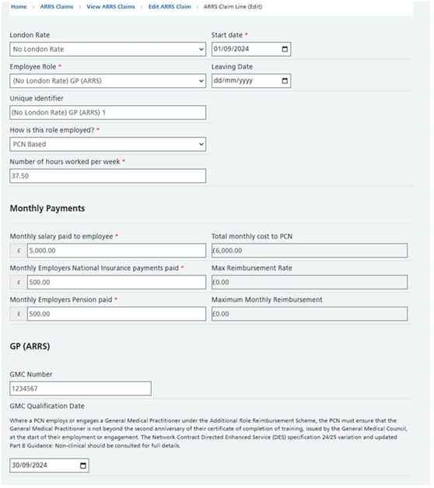
GP ARRS Role: Criteria for reimbursement
How many sessions is classed as full time?
Full time is listed in the documentation as 37.5 hours (10.5.7). How ever a practice manages this in terms of sessions is at their discretion.
Is there a minimum term that a GP role needs to be recruited for?
The contract can be for less than 6 months, unlike other ARRS roles, in recognition of the October start (DES 7.4.1).
The DES states that GPs cannot be claimed if they are to be employed in a temporary capacity i.e locums and they must be permanently employed so whilst no specific minimum requirement, it should meet these criteria.
What terms should be used when recruiting the newly qualified GP?
the PCN must ensure that the newly qualified GP is employed or engaged on terms and conditions which are no less favourable than those contained in the document entitled “Model terms and conditions of service for a salaried general practitioner employed by a GMS practice” (DES B19.4)
Our PCN has 4 practices, could we split the funding (equating to 8 sessions) so that each practice could recruit a GP on 2 sessions each?
Yes as long as the reimbursable rate and PCN allocation are not exceeded. All other criteria (eg within 2 years post CCT) also still apply
How should the PCN claim for a newly qualified GP?
PCNs will claim for the GP role(s) via the Workforce Portal and continue to be paid monthly, one month in arrears. (See screen shot to right)
PCNs will be asked to submit the GPs GMC number as part of the claim.

Slide 4
GP ARRS Role: Criteria for reimbursement
Can a GP be employed to work remotely?
Yes, remote working is allowed. The commissioner must be assured that the GP role meets all other criteria and will be delivering services as set out in the Annex to the DES.
Can a GP be engaged via an agency?
As with other ARRS roles, there are provisions for contracting via a third party.
There are several stipulations that must be met. The GP would need to be employed with a contract for the individual for a specific length of time or substantively. More than one contract with an agency is allowed. Employing an individual in this way attracts VAT (which cannot be claimed for).
The PCN or practice must not engage the agency as a service (which would not attract VAT). It must only be for a specific role for a specific GP.
The contract cannot be to fulfil ad-hoc or undefined late-fill shifts – this would constitute both locum working for the GP and the practice or PCN engaging the agency as a service rather than a vehicle for an Indvidual contract.
Neither VAT nor agency fees can be claimed for – just salary and on-costs - pension and NI contributions. This means it is more expensive to engage a GP via this route.

Slide 5




Scenarios
Eligible for ARRS GP Reimbursement?
Dr A completed GP Training in August 2023. Since then, she has been undertaking locum work.
Yes, if employed or engaged before August 2025
Dr B completed GP Training in August 2024 and immediately started a salaried position. This was offered in anticipation of the ARRS GP scheme.
No, unless the commissioner provides agreement on an exceptional basis
Dr C completed GP Training in August 2022 and has never held a substantive position.
No, beyond 2nd anniversary of CCT at the start of employment / engagement.
Dr D completed GP Training in February 2024 and was working under a fixed term to cover a maternity leave.
Yes, if employed or engaged before February 2026
Dr E completed GP Training in August 2024 and has been engaged by a locum agency and offered on a 6-month contract for the PCN to engage her for the ARRS scheme
Dependent on specifics – no, if the nature / characteristics are for temporary capacity including being subject to Agency Workers Regulations and engaged as a service.
Updated 14/10/2024
Note: Each scenario assumes all not mentioned criteria are met

Slide 6
Scenarios
Eligible for ARRS GP Reimbursement?
Dr F – completed GP Training in August 2023 and entered Public Health Training. During this time Dr F has provided a locum session at the same GP Practice.
Yes, if employed or engaged before August 2025.
Dr G completed GP Training in August 2023 and has been substantively employed in a Trust Grade role in A&E
Yes, if employed or engaged before August 2025.
Drs Ha & He completed GP Training in August 2024; a PCN wishes to substantively employ both for 0.2 FTE.
Yes, if employed or engaged before August 2026. Multiple GPs are permitted.
Dr I completed GP Training in August 2023 and has worked substantively as a 0.4 FTE GP. Can the PCN claim for additional sessions to increase Dr I to 0.8 FTE.
No, the GP has been substantively employed as a GP in general practice previously
Dr J completed GP Training in August 2023 and has worked substantively in a different practice to the prospective PCNs member practices
No, the GP has been substantively employed as a GP in general practice previously
Dr K completed GP Training in August 2024 and has been engaged by a federation and offered on a 6-month contract to the PCN for the ARRS scheme
Dependent on specifics – yes, if not intended to be for a temporary basis and engagement is for the individual
Updated 14/10/2024
Note: Each scenario assumes all not mentioned criteria are met

Slide 7
GP ARRS Role DES links
Location of DES documentation:
https://www.england.nhs.uk/gp/investment/gp-contract/network-contract-directed-enhanced-service-des/
Cover note: primary care networks- network contract directed enhanced service from Oct 2024
Network Contract DES – Contract specification for 2024/25
Network contract DES – guidance for 2024/25 in England – part A: clinical and support services (section 8)
Network contract DES – 2024/25: part B guidance: non-clinical
Network contract DES – template data sharing agreement
Network contract DES – template data processing agreement
Network contract DES – Sub-contract for the provision of services for 2024/25
Network contract DES – primary care network adjusted populations spreadsheet
Variation to the Network Contract Directed Enhanced Service Mandatory Network Agreement

