Slide 1

Admin Away Day 2025: Resource Pack

Slide 2
Contents
Topic | Slide
Flexible Staffing Pool: Receptionists & Administrators | 3
Apprenticeships | 4-6
GP Assistant Programme | 7
Wellbeing | 8
The Wellbeing Line | 9-10
Care First: Employee Assistance Programme | 11-23
Bitesize Lunch & Learn Sessions | 24
Care Navigation | 25
Digital Resources | 26
Gloucestershire Primary Care Training Hub | 27-28
Other Useful Contacts | 29

Slide 3

Flexible Staffing Pool Receptionists & Administrators
If you’re a Receptionist or Administrator in a substantive role in general practice who is looking to undertake additional work within Gloucestershire, please watch this video which provides details of the Flexible Staffing Pool for Receptionist and Administrator colleagues.

Slide 4


Apprenticeships
There are a wealth of different career paths available to Primary Care colleagues, whether you are interested in developing into a clinical / non-clinical role, there are options available to you.
If you’re interested in undertaking an apprenticeship, speak with your line manger/Practice Manager about your career path and career development and contact glicb.pcwc@nhs.net or Mandy Tuckey, ICS Apprenticeship and Widening Participation Programme Lead mandy.tuckey@nhs.net
You can find lots of information regarding Apprenticeships on our website

Slide 5
Apprenticeships Support & Resources
  From the training provider
  One Gloucestershire Apprenticeship Lead, Mandy Tuckey - mandy.tuckey@nhs.net
  IFATE: Home / Institute for Apprenticeships and Technical Education
  Gloucestershire Primary Care Training Hub -https://glosprimarycare.co.uk/apprenticeships
  https://amazingapprenticeships.com/ - resources, support for apprentices
  https://www.instituteforapprenticeships.org/ - look at apprenticeship standards available
  https://www.gov.uk/apply-apprenticeship - find and apply/look at what other employers are recruiting for
  https://www.apprenticeships.gov.uk/ - funding rules/guidance
  https://transfers.manage-apprenticeships.service.gov.uk– apply for a levy transfer

Slide 6
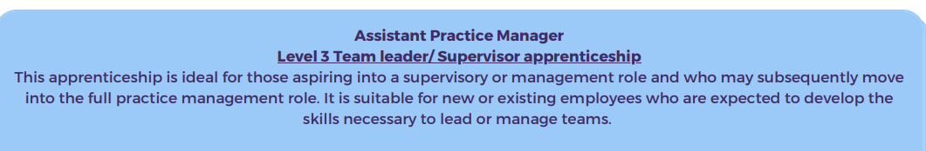
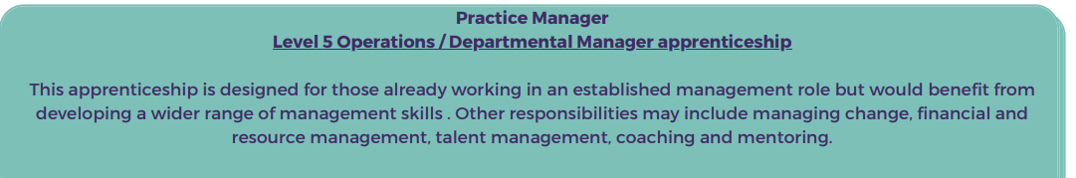

Apprenticeship Opportunities
Functional Skills - HASO (skillsforhealth.org.uk)
Notes:
Apprenticeships can be taught across a number of different levels depending on the experience of your staff and also the level of experience required for a particular role. Level 2 is the entry level and is the equivalent of GCSE. Level 3 is the equivalent of A levels. Levels 4-6 are at undergraduate level and level 7 is at masters level. Apprenticeships at level 3 and above will require the learner to have GCSE maths and English grade C/4 or a functional skills qualification. If you don’t have this then you will need to undertake functional skills training before or alongside your apprenticeship. This can be accessed free of charge through local and national providers. You can find out more information on the skills for health website (link on the slide)

Slide 7

GP Assistant Programme – Applications now open for 2025-26
The GP Assistant (GPA) programme continues to demonstrate significant value in general practice, helping to reduce the administrative workload of GP’s, enhance operational efficiency, and support workforce development. We are now inviting expressions of interest for the 2025/26 cohort and encourage practices to consider this funded training opportunity to upskill existing staff members who may already bring value to the role. By training a GP Assistant your practice can benefit from a more streamlined workflow, enabling GPs to focus on patient care while strengthening your multi-skilled team.
Programme highlights:
Level 4 qualification (equivalent to Foundation Degree)
9-month programme
One day per week off the job learning support (can be split throughout the week)
GP Mentor required to sign off work (other mentors can be used for support)
A funded programme £2,120 will be paid directly to the GP practice
Supports staff retention & development
Flexible role proven to improve access & streamline workflow.
For further information, application and evaluation of the programme please click here
GP Assistant Information Booklet https://devontraininghub.pagetiger.com/gpa/information-booklet

Slide 8


Wellbeing
We all have a part to play, consider for yourself, and encourage others, to: take a walk at lunch time, consider healthy snacks, step away from work spaces for a break, chat to colleagues
Support offers: NHS England » Support available for our NHS people

Slide 9

Unlocking confidential mental health and wellbeing support for anyone working in health and social care in Gloucestershire.
Call us on 0300 421 7500
Website: The Wellbeing Line | Selfcare is not selfish.
Our phone lines are open:
Monday/Tuesday/Wednesday/Friday 9.00am-4:30pm, Thursday 9.00am to 8.00pm

Slide 10



Resources:
You don’t need to struggle
Feeling overwhelmed
Are you feeling burnt out?
Thriving in GP
General Information
The importance of taking a break

Slide 11

Care first:
Your Employee Mental Health & Wellbeing Partner x
Gloucestershire ICB - GP Staff

Slide 12
How do we support your wellbeing?
Emotional Support 24/7/365
- In the moment support (Single Session Therapy)
- Discuss any home or work related issue confidentially
- Unlimited access
Short-term structured counselling
- Up to 6 sessions via telephone, video
Trained Information Specialists
Care first Lifestyle Website
My Possible Self mental health app

Slide 13
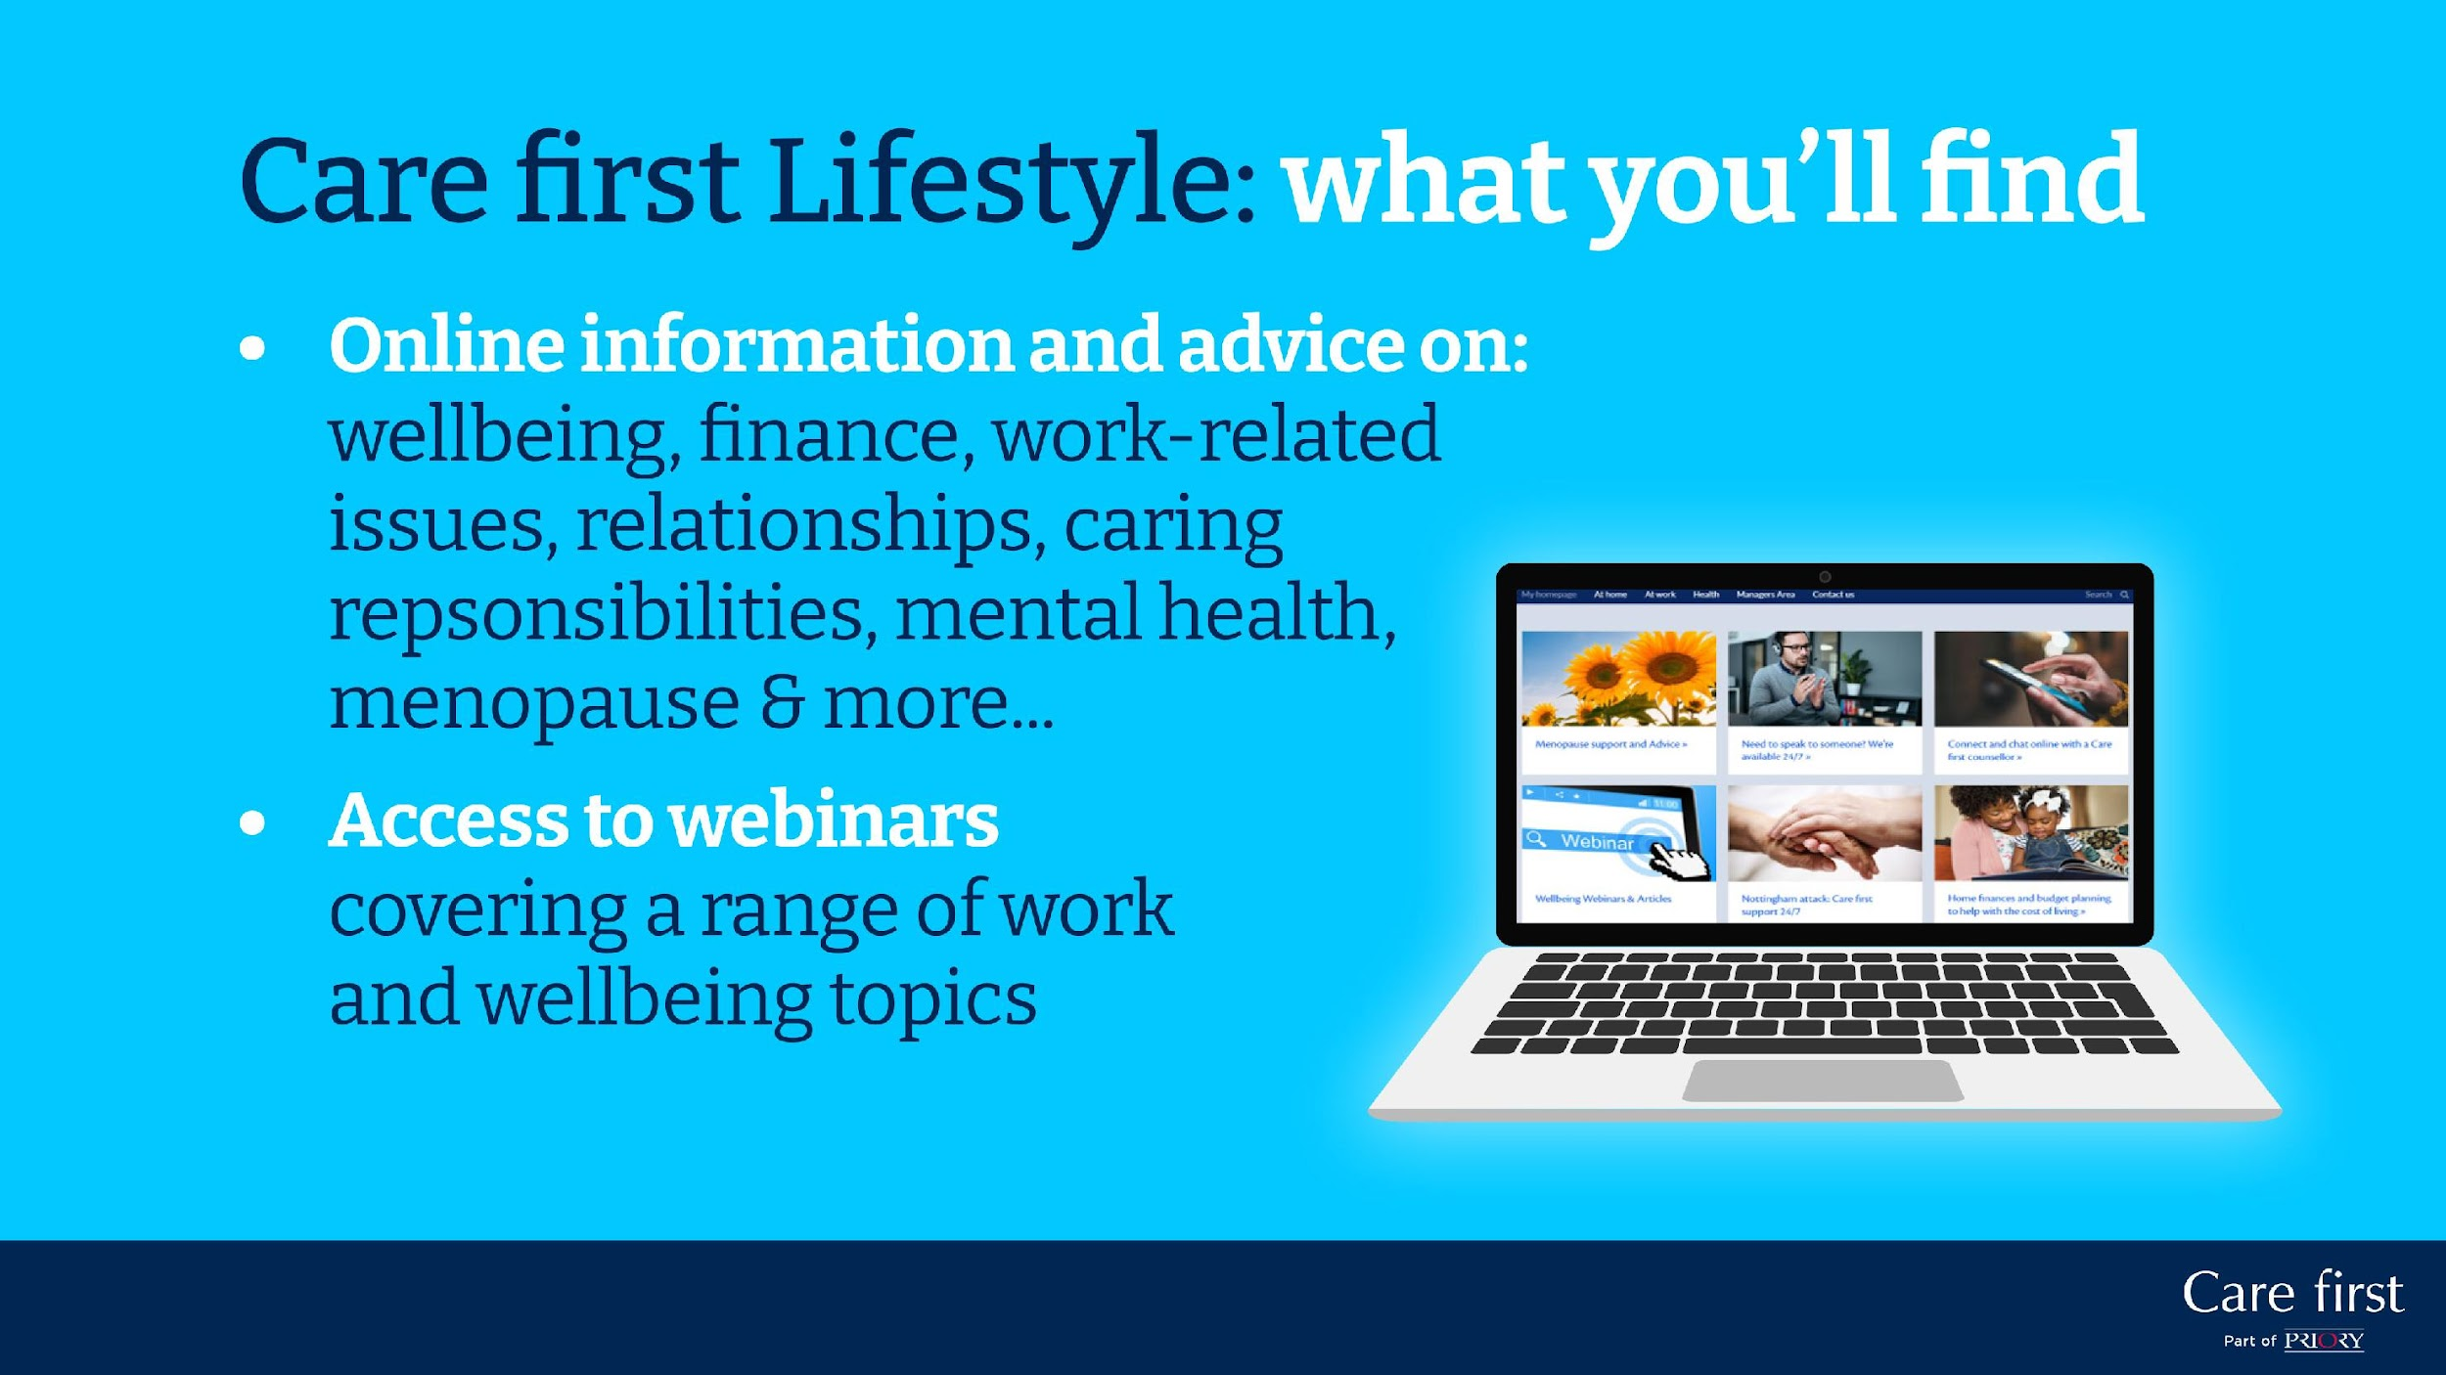
User Experience
Knowing what to expect when you reach out can help you to build the confidence to make contact….
Speak with emotional support counsellor / practical advice specialist
Period of reflection
Call back for further ad-hoc support
Clinical assessment (if appropriate)
Referral for structured counselling
Start solution focused sessions

Slide 14

Our Information Specialist Team
Citizens Advice Bureau trained specialists
Wide range of issues covered including legal, family matters, and probate
Practical advice and signposting
Save time searching Google and speak with a real person

Slide 15

Financial Wellbeing Support
We partner with PayPlan who can provide free, non-judgmental financial advice and personalised debt solutions.
Friendly, non judgemental advisers
Reduce money worries
Tailored debt solutions
Help towards a debt-free future
Reduced creditor calls when in a debt solutions

Slide 16
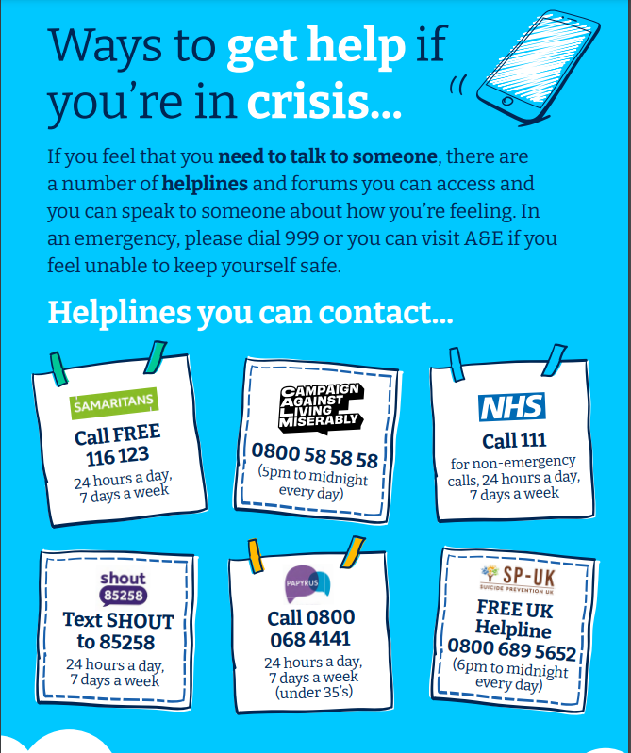
We are not a Crisis Line.

Slide 17


Slide 18
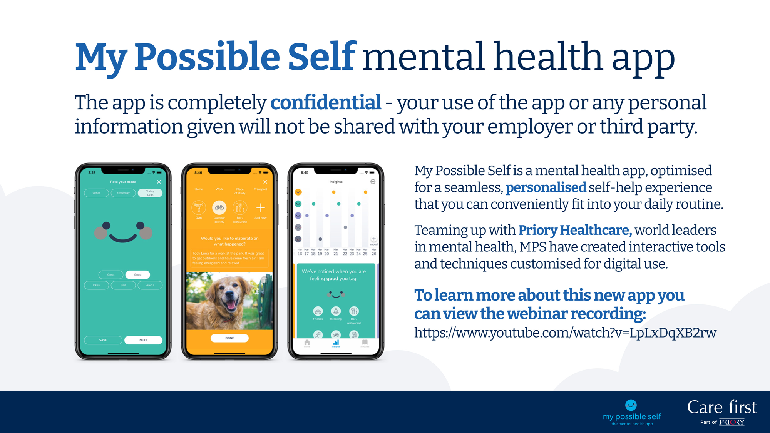
My Possible Self mental health app
Designed by Priory Healthcare, and certified by the NHS, our My Possible Self app allows you to manage your wellbeing and access a range of interactive tools and techniques customised for digital use!
Our app is optimised for a seamless, personalised self-help experience that you can conveniently fit into your daily routine.

Slide 19

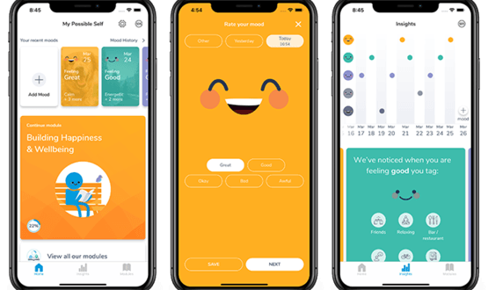
My Possible Self features
Toolkit – Tools to identify behaviours and monitor progress
Tags – Recognise the activities, people and places that influence your mood
Mood journal – Record how you feel and help you understand your moods
Insights – Understand yourself better and do more of the things you like
Journals – Record worries, emotions and actions in the moment
Visual and audio exercises – Boost your mood, relax your mind or drift off to sleep

Slide 20
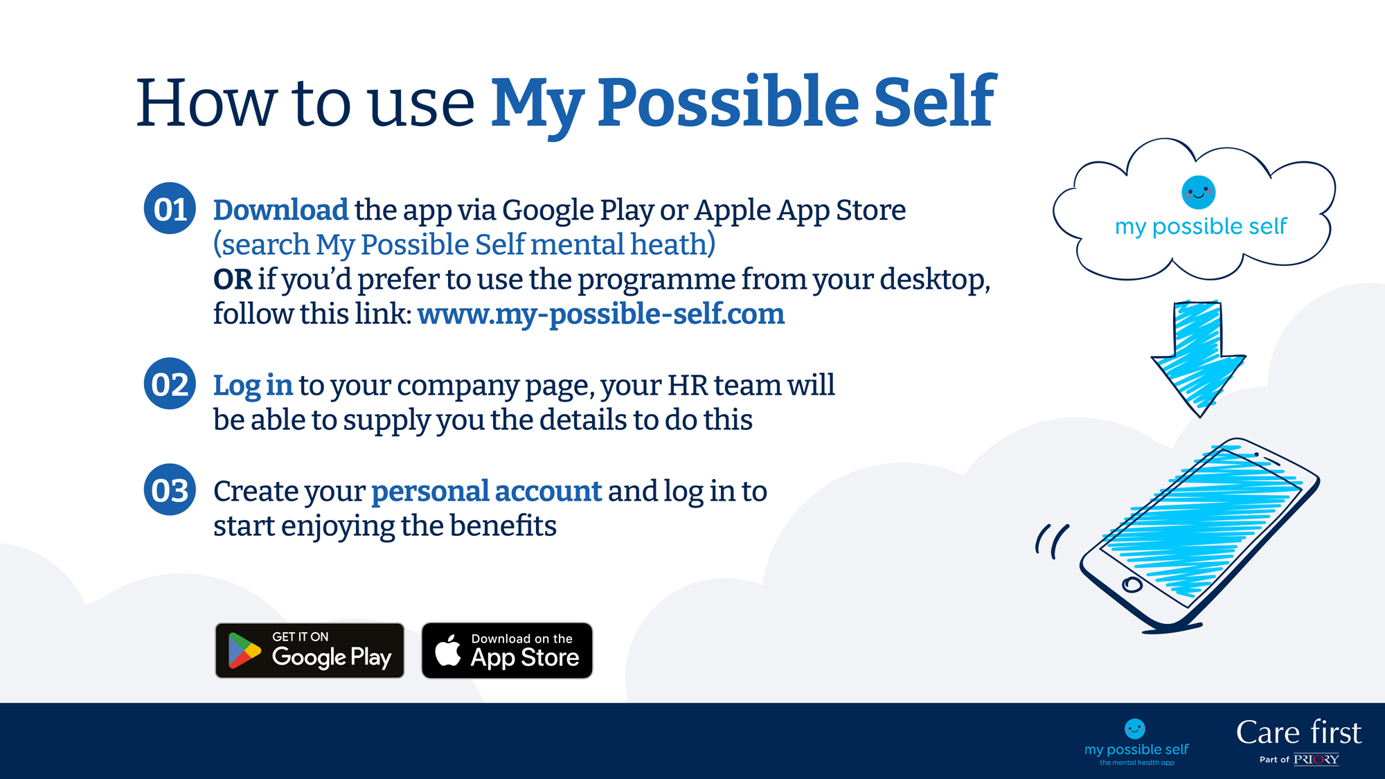



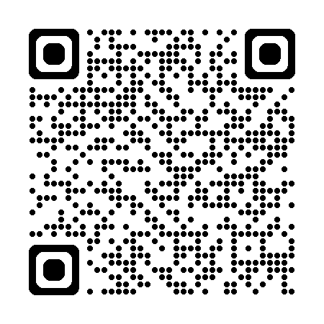
How to use My Possible Self
Download the app via Google Play or Apple App Store by scanning the QR code
Create an account and enter your unique organisational code: GLicB25!
Enjoy the benefits of the app!
Scan me

Slide 21
Care first Lifestyle: what you’ll find
Online information and advice on:
wellbeing, finance, work-related issues, relationships, caring responsibilities, mental health, menopause & more…
Access to webinars
covering a range of work
and wellbeing topics

Slide 22
Where can you find out more?
To find out more about how we can support you, and the types of issues we are best placed to support, please view our information hub: Care first | Linktree
User FAQs Guide
Your Services Explained
User Testimonials

Slide 23
Contact details
If you’d like to know more about Care first and how we can support you, please view our information hub on: https://linktr.ee/care_first
0800 174 319
Lifestyle platform login details:
Username: Gloucestershire
Password: GPSTAFF

Slide 24


Bitesize Lunch & Learn Sessions for Reception/Admin Colleagues
Health & Wellbeing – Dr Sarah Richards
Managing Medication Requests – Wendy Tyler Batt
Acutely Unwell Patients (Red Flag Training) – Dr Laura Halden
Conflict Resolution Training – Tory Brettell

Slide 25

Care Navigation Resources
Care Navigation Posters:
https://glosprimarycare.co.uk/wp-content/uploads/2023/07/Care-Nav-Poster-2-A4.png
https://glosprimarycare.co.uk/wp-content/uploads/2023/07/Care-Nav-Poster-A4.png
MiDoS Videos:
MiDoS Care Navigation Tool – YouTube
MiDoS Care Navigation Overview - YouTube

Slide 26

Digital Resources
IT helpdesk
e: ghn-tr.ITServiceDesk@nhs.net
t: 0300 422 2808
Digital resources on G-care: G-Care - The Digital Wire (glos.nhs.uk)
The majority of practices in Gloucestershire are using SystmOne (S1), with the remainder using EMIS. Training is available via the SCW, please visit (or speak to your line manager): Core clinical system (scwcsu.nhs.uk)
Learn to use S1 in 30mins: https://www.youtube.com/watch?v=Yms5iV4ceNc
More video guides at: https://youtube.com/playlist?list=PLDex7N6CQ9iEX0gPLhPV3qD_ZndeSi3D6
Online consultations- many practices will utilise online consultations through a variety of means, which may include:
Footfall G-Care - The Digital Wire - Project - GP websites (Footfall) (glos.nhs.uk)
E-consult G-Care - The Digital Wire - Project - Online Triage (eConsult) (glos.nhs.uk)
SMS services- accurx and Mjog G-Care - The Digital Wire - Project - SMS Messaging (AccuRx and MJog) (glos.nhs.uk)
Community Pharmacy Consultation Service https://ccglive.glos.nhs.uk/intranet/index.php/ccg-strategy/medicines-management/commissioned-community-pharmacy-services

Slide 27
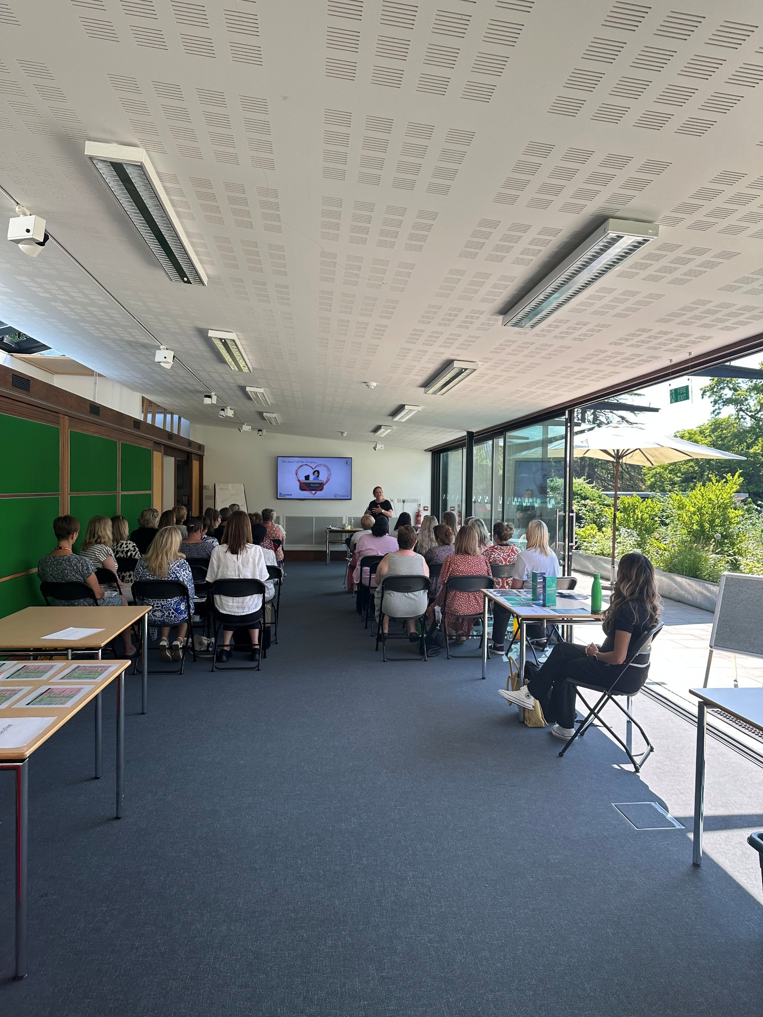
Gloucestershire Primary Care Training Hub
Supporting educational placements and expansion of supervisor/educator capacity
Career support from new to practice through to later career and beyond
Fellowship opportunities
We support with education, training and development for all staff in primary care, across clinical and non-clinical roles, and existing and newer roles. This includes:
Workforce planning
Support for PCNs
Embedding new roles through the additional roles reimbursement scheme (ARRs)
Facilitation of training for GPs and the wider primary care team

Slide 28
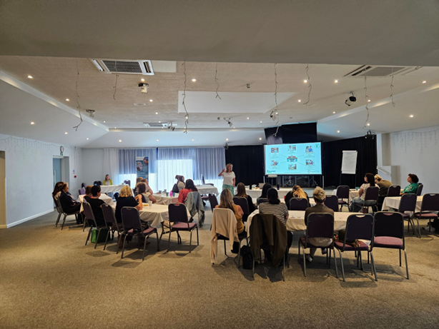
Gloucestershire Primary Care Training Hub
Basically, if you need help or support, we can usually point you in the right direction!
The training hub team is hosted within the Gloucestershire Integrated Care Board, supported by funding from Health Education England (HEE) and other sources
More information on training hubs can be found at: CLICK HERE
The best way to contact us is by emailing us on glicb.pcwc@nhs.net and we will ensure your query gets to the right member of the team (this includes getting in touch with any of our professional leads)
More information can be found on our dedicated Gloucestershire Primary Care Training Hub website at: Gloucestershire Primary Care Workforce Centre | Primary Care Resources (glosprimarycare.co.uk)
Find us on Facebook: Gloucestershire Primary Care Training Hub (facebook.com)

Slide 29
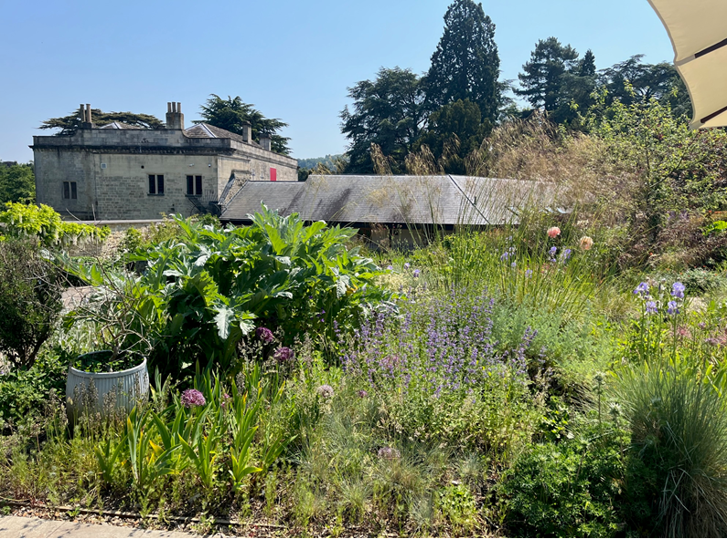
Other useful contacts
In the first instance please look to raise any concerns you have with your Practice Manager. You Practice Manager will also be able to escalate any issues to the Leads in your PCN on your behalf.
Freedom to Speak Up Guardian: Nic Wright nicwright@gloslmc.com

