Slide 1








PROGRAMME OVERVIEW
Level 3 Business Administration with Level 2 Medical Terminology
in the NHS

Slide 2










Our Customers
Who We Work With

Slide 3







Our Apprenticeship Programme
Business Administrator
We’re a multi-award-winning provider of Business Administration Apprenticeships and have used our expertise to design a programme that meets the unique needs of the NHS. Our apprenticeship equips learners with the skills, knowledge, and behaviours required to deliver high-quality administration—supporting the smooth running of services and improving patient care.
A strong and efficient administrative function is vital across every NHS department, from frontline services to back-office operations.
74
%
OF APPRENTICES ACHIEVE
DISTINCTION
Level
Duration
Learning Method
Location
37
%
ABOVE
Level 3
15 Months
Work-based
Remote
THE NATIONAL AVERAGE

Slide 4




Job Titles Include:
Ward Clerk
Medical Secretary
Medical Summariser
GP Receptionist
Clinical Coder
Administrator
Medico- Legal Personnel
Entry Requirements
There are no formal entry requirements for the Level 3 Business Administrator apprenticeship. Prior to enrolment onto this apprenticeship we’ll conduct a skills scan with all candidates to ensure this is the right course to support their ongoing professional development
Progression Routes
From the Level 3 Business Administrator apprenticeship it is possible to progress onto other apprenticeships such as:
Level 3 Team Leader
Level 3 Customer Service
Level 3 Data Technician

Slide 5




Key Criteria
What Is Expected Of You
Take early personal responsibility, show initiative, be able to challenge managers and peers, putting forward their own ideas and suggestions and identify, lead and manage small projects for business improvements.
Support, others and give feedback on work completed. To be able to coach other staff and gain their positive feedback.
Take responsibility, identify, lead and manage a substantial improvement project for the business, of between 21 – 35 hours.
Achieve a good standard of written work, to complete all the reports required.
Be able to arrange logistics including for meetings and events.
Achieve a good range of IT skills including involvement of social media to create the evidence required.

Slide 6






LEARNING METHODS
Skills, Knowledge and Behaviours
Monthly workshops, delivered remotely
Tripartite Review every 8-10 weeks
Level 2 Maths and English Functional Skills
6 hours per week Off the Job Training
Objective EPA with Final Grade of Fail, Pass or Distinction
15 Months + EPA

Slide 7





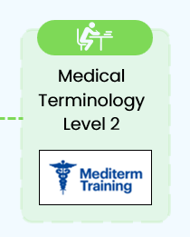
Learner Journey
Business Administrator
Duration: 15 months
Month 1
Month 2
Month 3
Month 4
Month 5
Induction to Business
Administrator qualification
Understanding the Organisation
Value of skills
Stakeholders
Relevant regulation, Policies and Processes
Month 6
Month 7
Month 8
Month 9
Month 10
Business
fundamentals
External environment
factors
IT
Record and document
production
Decision making,
Interpersonal skills,
Communications
Month 11
Month 12
Month 13
Month 14
Month 15
Quality
Project
Management
Professionalism,
Personal qualities, Responsibility
Managing Performance
Preparation for End-Point Assessment (EPA)
EPA
SPARK ACADEMY PATHWAY
Knowledge and behaviours test, Portfolio of evidence and discussion,
Project presentation
Key
Workshop
Self-study
1:1 Learning Session
Mentoring/Shadowing

Slide 8



End-Point Assessment
Level 3 Business Administration Apprenticeship
Final Project presentation slides and question/answer session
Portfolio and Professional Discussion
Multiple Choice Knowledge Test
15 mins Project Presentation, followed by a structured Q&A session between the apprentice and their independent end Assessor, centred around the project evidence of 15 minutes.
Interview with portfolio of evidence of 45 minutes. Guided discussion with Assessor about evidence produced from real-work throughout the course of the apprenticeship
The knowledge requirements within the Standard will be tested using 50 multiple-choice, on -screen questions over 1 hour test.

Slide 9

End-Point Assessment
Process Improvement / Project Examples
At EPA you must complete a presentation on a Process Improvement / Project you have undertaken. The project/process improvement must be relevant to your place of work, and incorporate planning, managing, communicating with stakeholders and monitoring / reporting on the result of your project.
You should not start your project or process improvement before month 9 of your apprenticeship. When it comes to presenting your project, you might like to use PowerPoint or Prezi - Business Administration Level 3 Project/Improvement by ruby garlick (prezi.com)
Real Life Examples:
An Improvement to a Quality Management System, identifying non conformances and enabling them to improve their systems
An improved Business Continuity Plan to meet ISO 9001, 14001 and 45001 requirements, which enable them to win more business/tenders
HR based project that decreased the time it took for staff to be approved and authorised to work
Laboratory based project, consisting of surveying staff to identify training needs, improving the process used for testing samples and producing a training manual for staff – cost and time benefit
Planning an Away Day including food and interactive events
Building a website
Improvement of online forms processes
New Starter / Employee guide or a training guide for colleagues
Setting up a new HR inbox to identify trends in patterns and volume of HR related issues

Slide 10


What we offer
Specialist Qualification
In partnership with Mediterm Training, Spark Academy combines NHS-specific learning with our high-quality apprenticeship delivery. Business Administration Level 3 apprentices have the opportunity to complete a Level 2 Medical Terminology qualification after completion of their apprenticeship. This integrated approach ensures that apprentices not only develop strong administrative and organisational skills, but also gain sector-specific knowledge that supports the unique needs of their role and the wider NHS workforce.
The Level 2 Medical Terminology qualification is designed for individuals working in the healthcare sector in roles such as ward clerk, medical secretary, summariser, GP receptionist, clinical coder, administrator and laboratory staff.
Course Includes:
Level
Level 2 Medical Terminology
Duration
70 hours depending on learner style and pre-existing knowledge
Basics of Medical Terminology – word building
Major bones of the body
Common roots, prefixes and suffixes
Pharmaceutical abbreviations
Classification of drugs
Anatomy and Physiology of the body systems
Instruments and investigations
Medical Specialities and personnel
Medical Abbreviations
Blood tests
Learning Method
Self-guided
Location
Remote

Slide 11

Off The Job Training
This is learning which takes place outside of day-to-day work duties and leads towards the achievement of the apprenticeship. It takes places during normal contracted work hours. The off the job training must be directly related to the apprenticeship and should be a minimum of 6 hours each week. Your Training Plan details how your Off the Job Training is planned for your apprenticeship. Examples of off the job include:
Workshops / 121 tutorials
Online learning and webinars
Podcasts
Relevant reading and research
Job shadowing and mentoring
Writing assignments
Reflective journals
Revision
Role play

Slide 12

Functional Skills
English and Maths
The Achievement of Level 2 Functional Skills is a Government requirement for anyone aged 16-18 (at the start of their apprenticeship) undertaking an apprenticeship at Level 3 or above who does not have GCSE English and Maths at Grade C/4 or above (or equivalent) on entry to their apprenticeship programme.
The achievement of Level 2 Functional Skills will need to take place prior to the End Point Assessment of the apprenticeship.
For anyone aged 19+ you or your employer can still choose for the to study towards an English and maths qualification.
The delivery of the functional skills will be led by your assigned Development Coach supported by our Functional Skills Tutor and VLE learning platform.

Slide 13


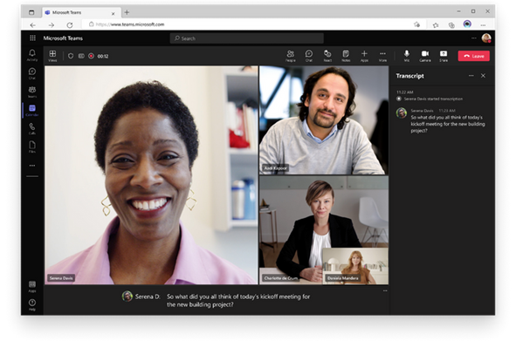
How You Will Learn
Online Learning
Monthly NHS Cohort Workshops for 3 hours per month, providing a flexible and accessible platform for learners to engage, collaborate, and access resources from any location.
Microsoft Teams
Engage in learning anytime, anywhere, reducing staff time away from the workplace
Bring apprentices together from multiple work locations
Live interaction, participation, and feedback led by the Development Coach
Integration to Office 365 applications
Access from multiple devices
Workshop recording
Live transcripts

Slide 14

NEXT STEPS:
Approval is required from your line manager AND Apprenticeship Lead - early action is recommended to avoid delays
Complete your application form and return to your Trust Lead, please also let us know that you have submitted your expression of interest, pending approval Academy@dbc-training.co.uk
Once approved, complete your brief online maths and English assessments prior to enrolling (BKSB)
A member of the DBC Team will reach out once we receive your application form to book a meeting with yourself and your line manager to confirm suitability and book your enrolment in
Enrolments will take place in late February / early March for both cohorts

